Slide 1
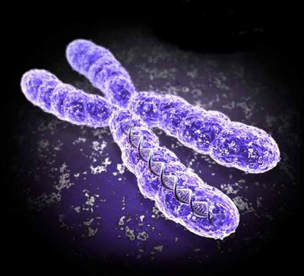
Unit 5: biological inheritance

Slide 2
Important vocabulary
TRAIT: carácter
GENE: gen
ALLELE: alelo
HOMOLOGOUS PAIRS: cromosomas homólogos
LOCUS: locus (lugar)
HOMOZYGOUS: homocigoto
HETEROZYGOUS: heterocigoto
HYBRID: híbrido
PURE-BREEDING: raza pura
DOMINANT: dominante
RECESSIVE: recesivo
GENOTYPE: genotipo
PHENOTYPE: fenotipo

Slide 3
Genes and genotype
A GENE is a piece of DNA that carries a treat and transmits genetic information.
A Genotype is the set of genes that an individual has. It is the set of observable traits.
A gene can have different variants. Each variant is called an allele. Individuals have two alleles for each trait.
If both alleles are identical: homozygous
If both alleles are different: heterozygous

Slide 4
BEFORE SOVING A PROBLEM
You need to stablish the letters you will use:
Upper case for DOMINANT ALLELES
Low case for RECESSIVE ALLELES
TWO LETTERS PER TRAIT (one coming from the mother and the other from the father)
Two identical letters: homozygous
Two different letters: heterozygous

Slide 5
DOMINANCE AND CO-DOMINANCE
THE DOMINAT ALLELE is stronger than the recessive, that’s why it is going to be present and to give the phenotype when it is present.
Ex:
Nn and NN are going to have the same phenotype when N is dominant.
THE CO-DOMINANT ALLELES are present together. The phenotype can be intermediate. Both alleles are equally strong.
Ex: NN one phenot, Nn intermediate and nn is the second phenotype.

Slide 6
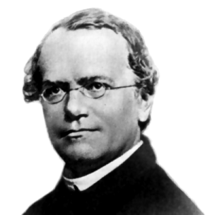
Mendel
Gregor Mendel (1822-1884) was the first one to study the transmission of biological traits.
He used pea plants which are easy to manipulate, self- pollinate, the varieties show pure traits and are easy to identify.
He statistically analysed the data.
http://anthro.palomar.edu/mendel/mendel_1.htm

Slide 7
Mendel’s work
Mendel carried out esperiments using a method:
He selected individuals of pure breeds which differed in only one or two traits: Parent generation or P.
He crossed the different varieties of P to obtain the F1 generation (Filial generation), which he called hybrid.
Then he crossed individuals from F1 by self-fertilisation and studied the descendants, F2 generation.

Slide 8
Mendel’s first law
First law or the uniformity of the first filial generation:
When two pure breeds which differ in one trait are crossed, all the hybrids formed in the first generation (F1) are identical to each other and to the dominant progenitor.

Slide 9
Mendel`s second law
Or the Segregation of traits in the second filial generation:
The traits that are together in heterozygous individuals, segregate (separate) when the gametes are formed and are passed independently to the second generation (F2).

Slide 10
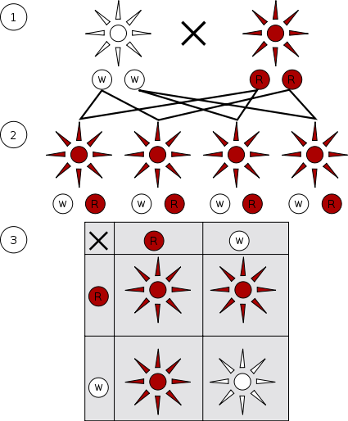
1: first law 3: second law

Slide 11
The punnet square
A table which genetists use to show the combinations of alleles of the gametes and the proportion of the descendents.
AAxaa | a | a
A | Aa | Aa
A | Aa | Aa

Slide 12
Mendel’s third law
Or Independent assortment of traits: Different traits are transmitted independently of each other, so all the possible combinations can appear in the descendants.

Slide 13
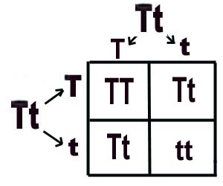
3th law: one trait

Slide 14
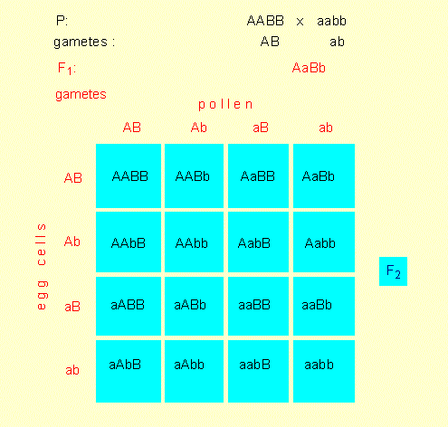
Punnet square: third law

Slide 15
Variations in mendelian inheritance
When the 1st law does not apply: intermediate inheritance and co-dominance.
(colors and blood-groups)
When the 3rd law does not apply:
Genetic linkage: genes that are in the same chromosome.
Genetic recombination: after crossing-over
T.H. Morgan discovered the recombination in the first decade of 20th century-

Slide 16
The genetics of sex
Chromosomal determination: XX, XY (Mammals, equinoderms and molluscs XY is male; in birds the male is XX, butterflies: the male is XX and female is X.)
Environmental determination: temp, humidity, pH, etc: amphibians and reptiles.
Genetic determination: due to a gene with several alleles.
Karyotype determination: insects (bees): diploid is female and haploid is male (droids)

Slide 17
Sex-linked inheritance
The human sex chromosomes: X and Y have morphological differences: Y is smaller and they have different genetic contents.
Homologous segment: where the genes that govern the same traits are found
Differential segment: genes that are only found in one chromosome
Female can be a carrier (portadora) of a recessive trait when she is heterozygous for the trait.

Slide 18
Ssex-linked inheritance
Colour blindness and haemophilia (inability to distinguish red and green, and non coagulation of blood) are produced by recessive genes in X chromosome.

Slide 19
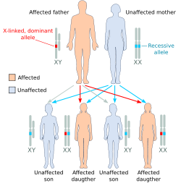
X-linked dominant allele, affected father

Slide 20
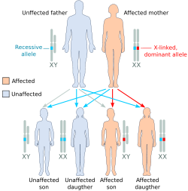
Affected mother

Slide 21
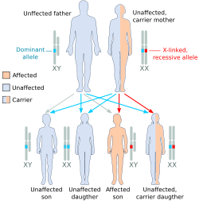
X-linked recessive . Carrier mother

Slide 22
Familiy treEs (pedigrees)
Family trees are graphs that contain all the members of the family of many generations and it shows one, or more treats.
They can be used to study and follow the presence of certain treats in the family.
Symbols:
Female:
Male:
Affected people:

Slide 23
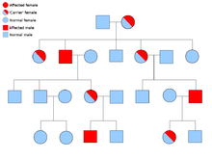
Family tree (example)

